Slide 1
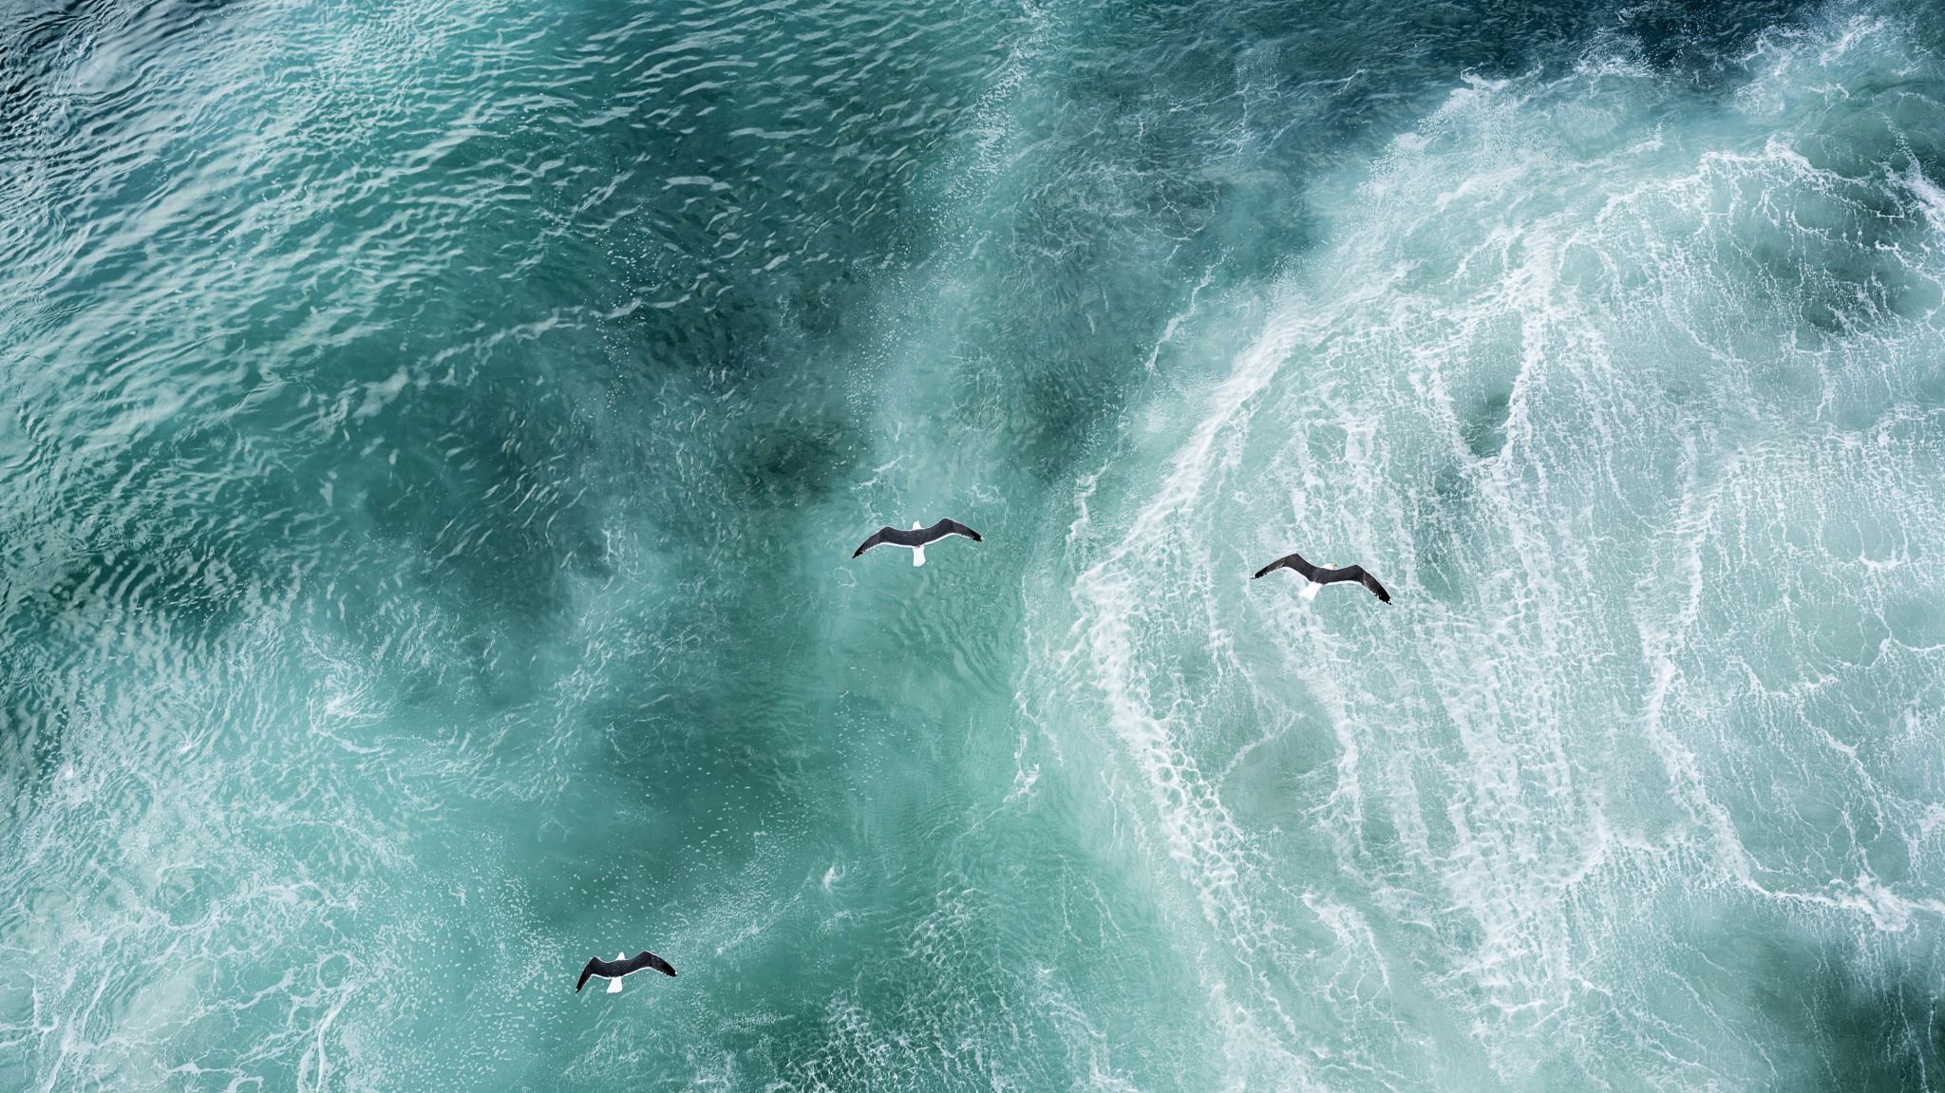
MINOR PROJECT ANALYSIS AND PREDICTION OF MARINE LITTER CONTRIBUTION BY DIFFERENT COUNTRIES
PROJECT GUIDE-Dr.A.SHIRLY EDWARD
S SEETHALAKSHMI [RA1811004040001]
M RADHIKA [RA1811004040019]
ECE-A, iV YEAR

Slide 2
ABSTRACT
Plastic is a synthetic organic polymer made from petroleum with properties ideally suited for a wide variety of applications. Over 300 million tons of plastic are produced every year.
At least 8 million tons of plastic end up in our oceans every year. Floating plastic debris are currently the most abundant items of marine litter. Waste plastic makes up 80% of all marine debris from surface waters to deep-sea sediments.
Plastic has been detected on shorelines of all the continents, with more plastic materials found near popular tourist destinations and densely populated areas.
Marine species ingest or are entangled by plastic debris, which causes severe injuries and deaths. Plastic pollution threatens food safety and quality, human health, coastal tourism, and contributes to climate change.

Slide 3
PROCESS
It is really important to analyse the contribution of marine litter by different countries during various years.
Firstly, it is necessary to know the rivers that get littered the most, eventually resulting in ocean pollution as the rivers reach them.
Analysing the datasets that inform the degree of plastic litter in various rivers from different countries would help in visualising the contribution of every country taken into account, importantly in visualising which country contributes the most.
After visualising data from various years , predictions can be made on future contributions by these countries.
Different data visualization and machine learning techniques can be used for this purpose.

Slide 4
FLOW CHART
Dataset Acquisition
Plotting data distribution
Analysis and Visualization
Training and Prediction

Slide 5
TECHNOLOGY USED
Python 3
PLATFORM USED
plastics-top-rivers.csv
Spyder IDE
LIBRARIES
DATASET
matplotlib.pyplot
numpy
seaborn
pandas

Slide 6
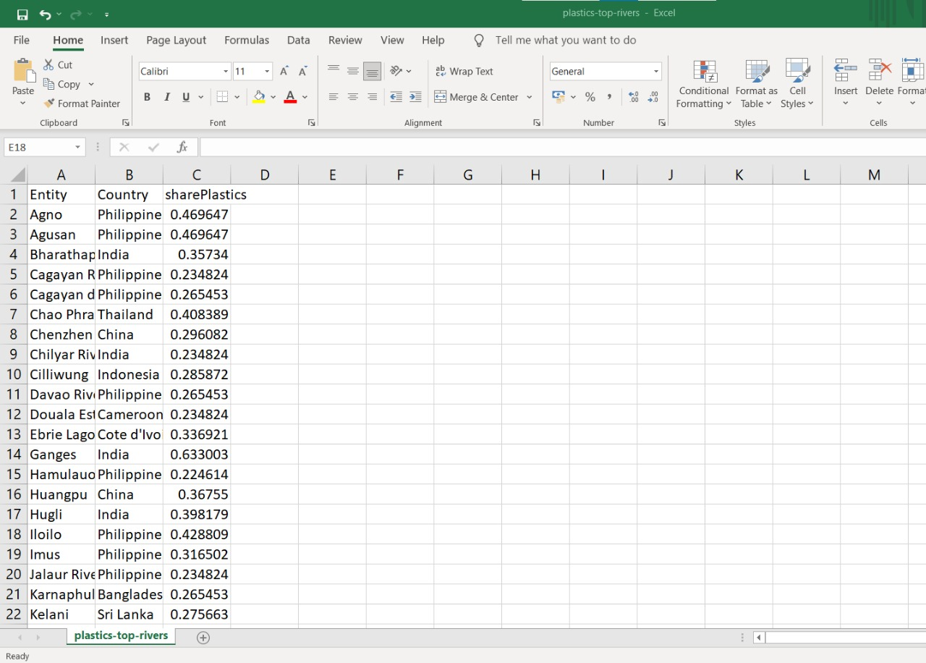
DATASET AND REFERENCE https://www.kaggle.com/ https://www.iucn.org/

Slide 7
FURTHER...
Implement data visualization using technologies mentioned above.
Training the dataset using ML algorithm.

Slide 8
THANK YOU

